Slide 1
C
α₂
3
B
E
4
ω₂
2
1
A
D

Slide 2
Consider the equivalent mechanism
C
α₂
3
B
E
4
ω₂
2
1
A
D

Slide 3
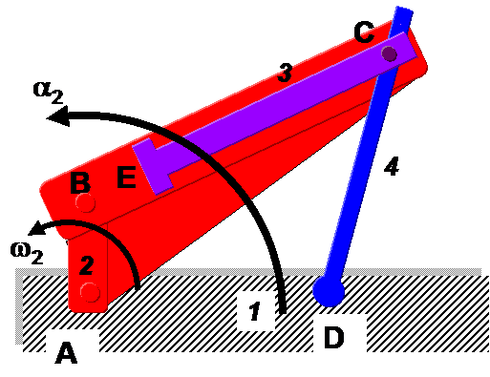
V_{C2} = ω₂XAC
V_{C3} = V_{C2} + V_{C3C2}
V_{C4} = V_{C3}
V_{C4} = ω₄XDC
V_{C3C2} = V_{C3C2s}
Velocity vector lines are perpendicular or parallel to lines, indicating the displacement vectors, appearing on the mechanism. Diagram is schematic, not to scale
C₂
V_{C3C2}
V_{C2} = ω₂XAC
C₃ , C₄
O_{V}

Slide 4
a_{C2,n} = ω₂²AC
a_{C2t} = α₂AC
a_{C2,} = a_{C2,n} + a_{C2,t}
a_{C3} = a_{C2} + a_{C3C2}
= a_{C2n}+a_{C2t}+ a_{C3C2n}+ a_{C3C2t}
= a_{C2cen}+a_{C2ang} + a_{C3C2cor} + a_{C3C2s}
a_{B3B4cor} = 2ω₄V_{B3B4s}
Magnitudes and directions of all ω s are available from velocity diagram. B, E may be found once unknowns are obtained by finding C.
O_{a}
a_{C2n} = ω₂XAC
a_{C4n} = ω₄XDC
a_{C2t} = α₂XAC
C₂
a_{C4t} = α₄XDC
a_{C3C2 cor}
C₃ , C₄
a_{C3C2 s}

